Slide 1
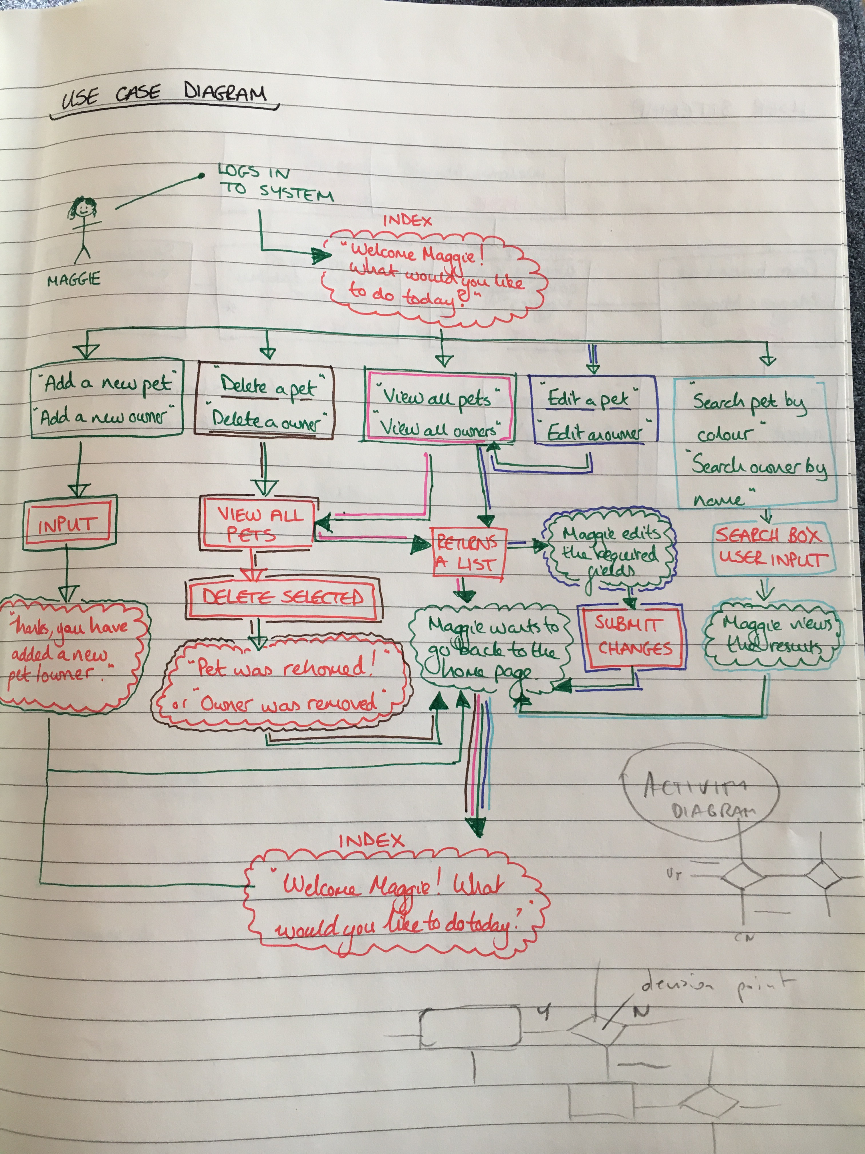
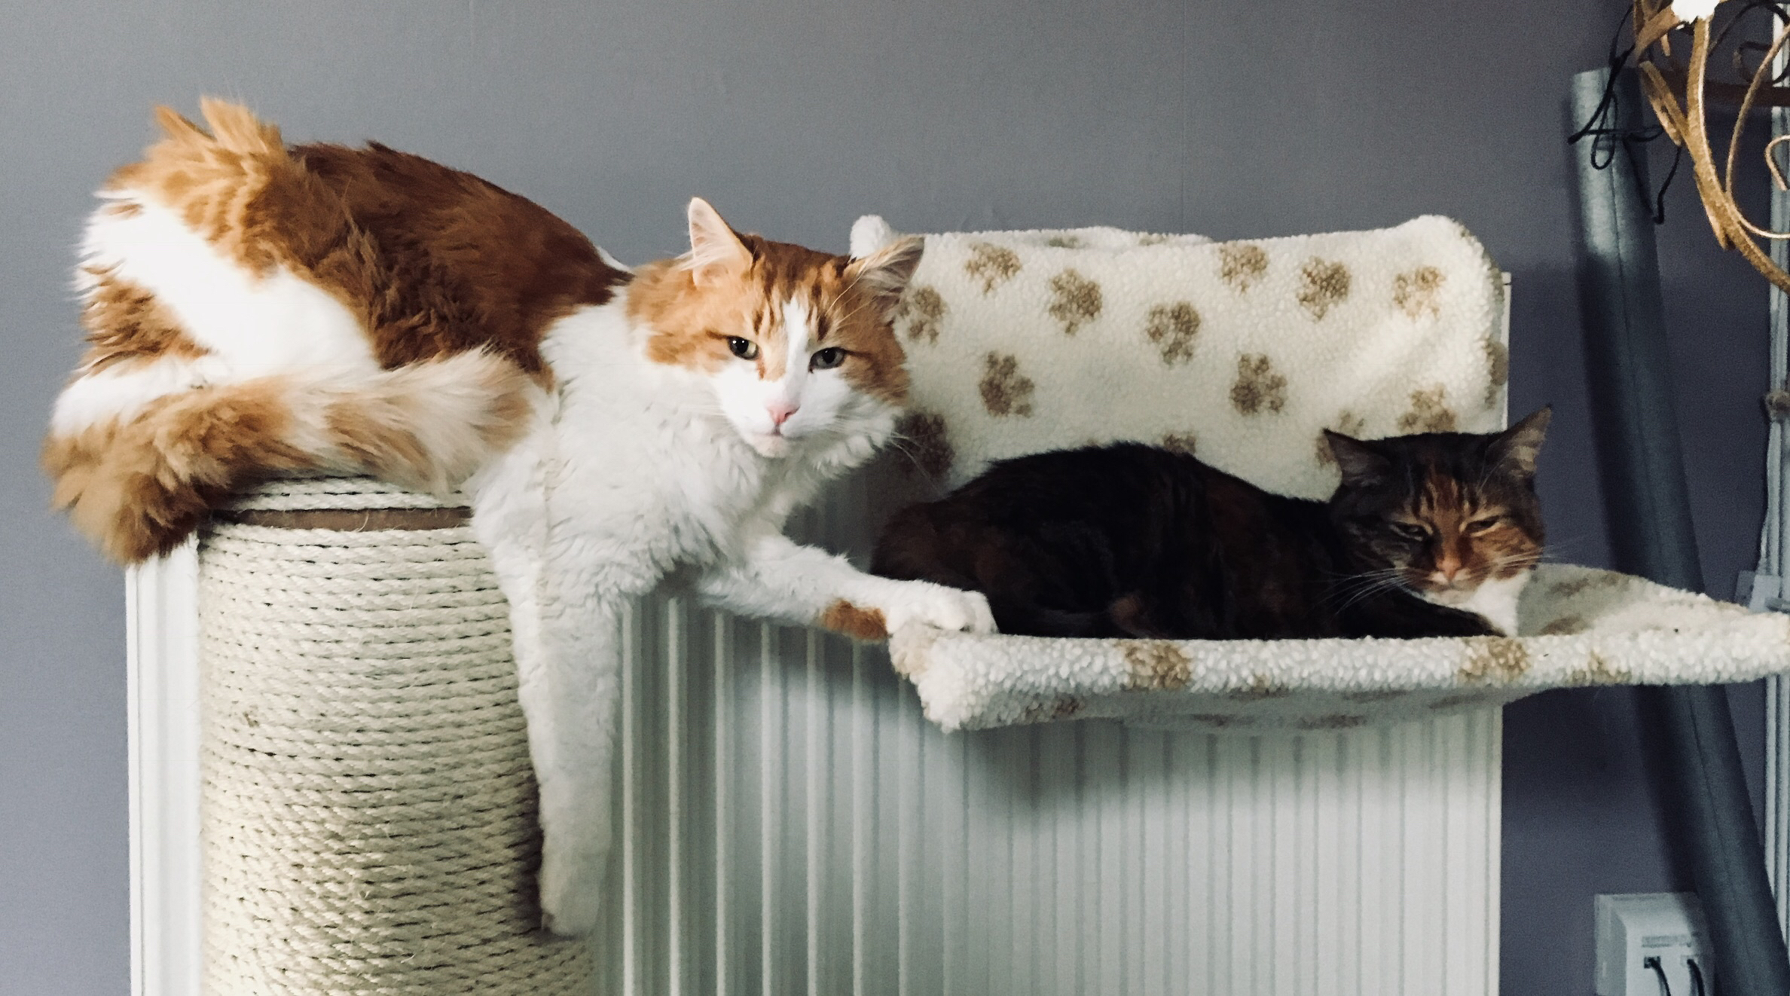
Project Week: Cat Shelter
Or is it…!
>.<
Because cats…yay! <3
Rachael Ellen, E20, Codeclan

Slide 2
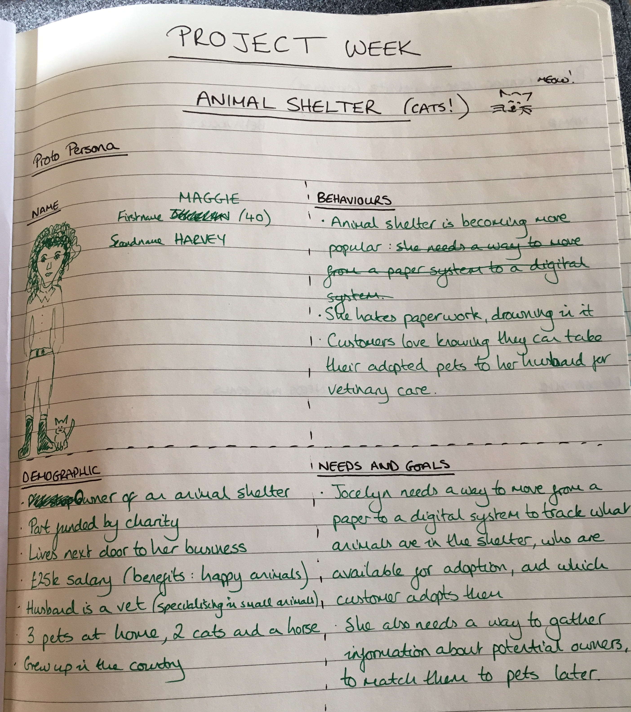

Project Startpoint
Weekend and Monday: user group (thanks Mum and Dad) and UX experience
Eureka moment…made me realise it’s for a management system!

Slide 3
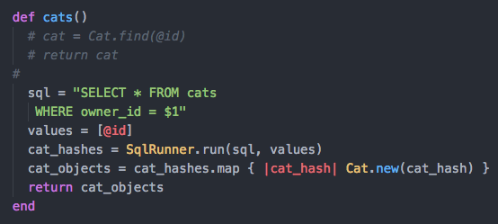
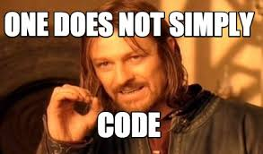
Main confusion 1: I couldn’t work this out… which id belongs to which class?

Slide 4
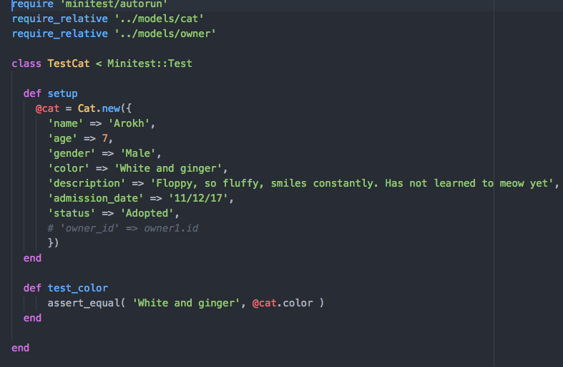

Main confusion 2: TDD
Token specs file, redundant I think…

Slide 5
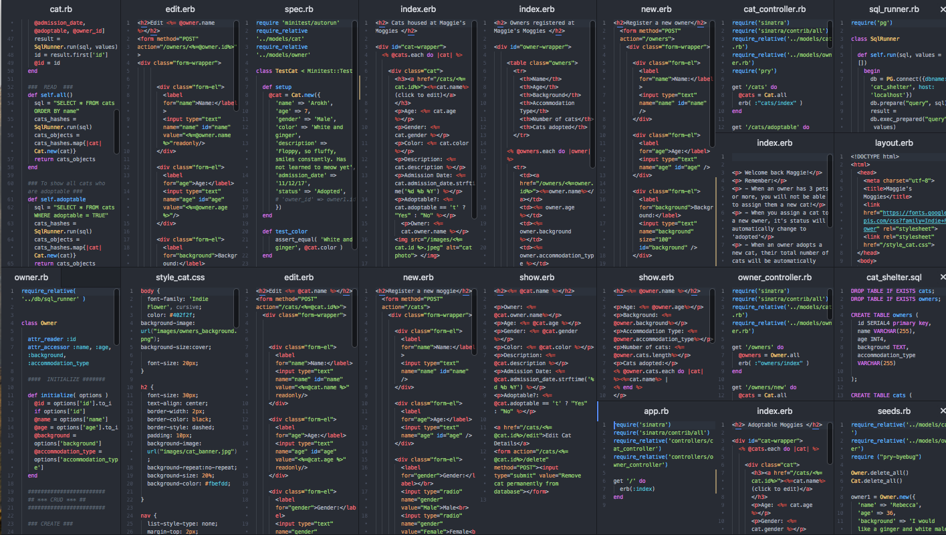
After a handful of database errors… and a truck tonne of Sinatra errors…
Let’s take a look. By the way, there’s 21 files of code sitting behind this kitty pad.

Slide 6
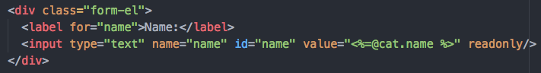
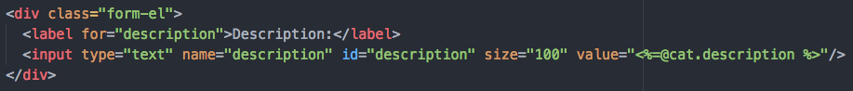
Some tricks I learned along the way
Read-only boxes
Description box length
Google fonts only work when you have internet…!

Slide 7

Time…if I had more of it
Flex the navigation bar
Make neater and prettier buttons
Add photo to page when adding a new cat
Remove comma at the end of last cat listed
Currently Maggie can’t adopt a new cat (she has more than 3): would need to make another logic statement to address this.
And, learn how to host this as an actual domain that would be usable away from this computer?

Slide 8
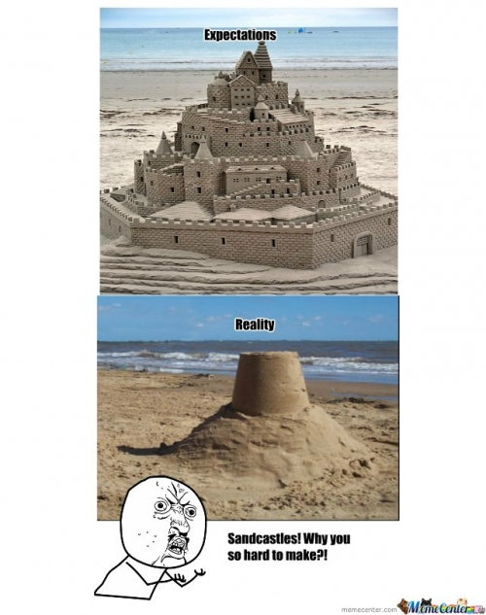
Achieved a lot in 5 weeks ☺
Thank you so much to Pawel, Keith and Sandy (and Sian!)
Thank you so much all my awesome E20-ers
Thanks Google for letting me borrow cat images temporarily

